Slide 1
Hydrogen Merchant Market
October, 2024

Slide 2
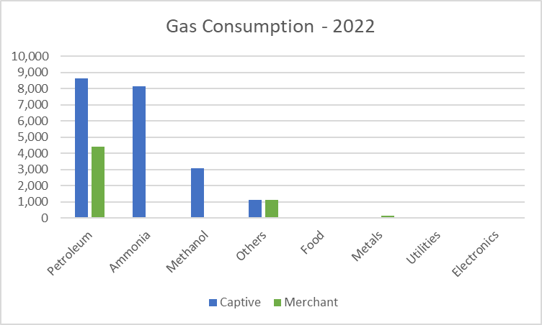
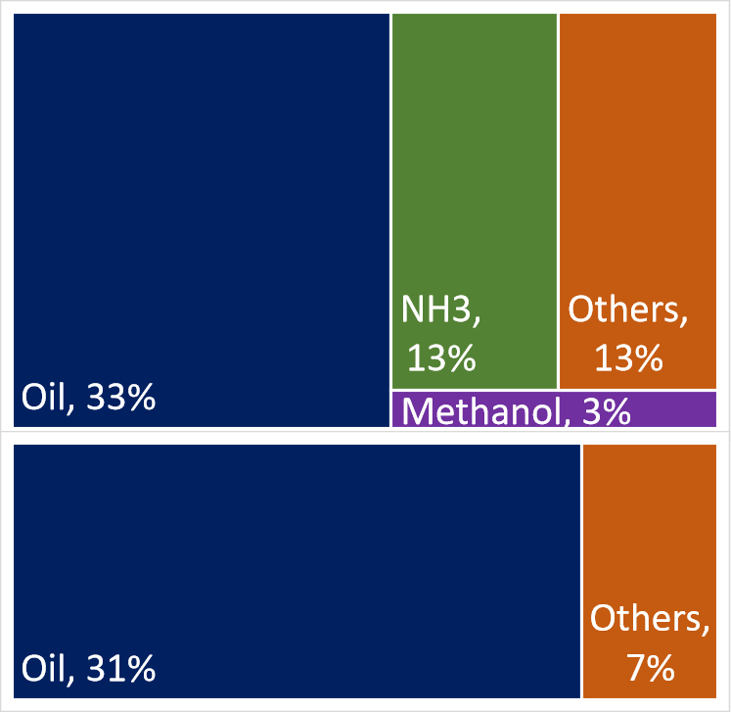
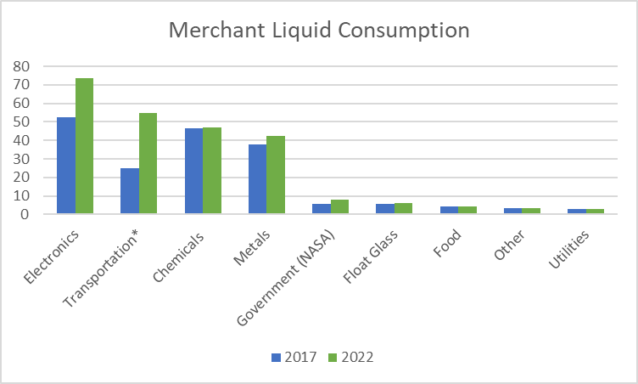
US Hydrogen Annual Supply and Demand Dedicated and By-product Production
US Hydrogen Demand – 15 MMT
On-site by-product or SMR produced gas
<0.1% Electrolysis
Opportunities
Ammonia
Methanol
Others
Captive Production 9.3MMT
Merchant Production 5.7MMT
330T/day – trucked liquid
Opportunities
Electronics
Transportation
Chemicals
Metals
Mostly gas pipeline
Source: Bloomberg NEF, IHS Markit, Industry Knowledge

Slide 3
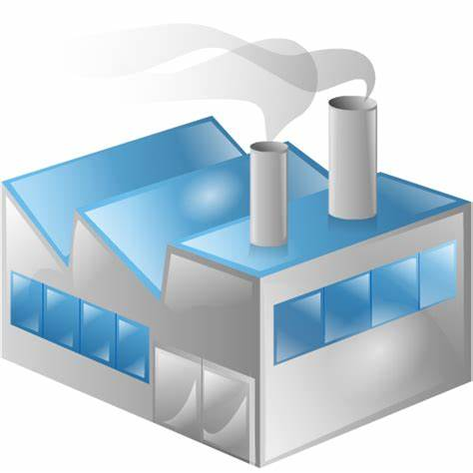
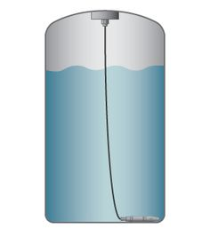
US Hydrogen Production, Delivery, and Consumption (2024 est.)
Producers
Distribution
Consumers
Industrial demands are Centralized
Distributed on-site generation
Direct consumption
Variable Purity
Some delivered Liquid
Transport fuel demand is Distributed
Centralized liquefaction
Over road delivery
Local high-pressure fuel ‘Stations’
25,480 T/day
On-site Low Pressure Gas
Oil
Steel
Cement
Ammonia
Glass
Semiconductors
Methanol
By-Product GH2 Producers
15,336 T/day
Truck/Pipeline Gas
210 T/day Trucked Liquid
Industrial Gas Companies
GH2 & LH2
Aerospace
55 T/day Trucked Liquid
Emerging Producers
GH2 and GH2
65 T/day Trucked Gas and Liquid
Transportation

Slide 4
Industrial US Hydrogen Demand 2022 Short Tons per Day
 | Merchant |  | Captive
SECTOR | Liquid | Gas | Liquid | Gas
Petroleum Refining | 0 | 4,850 | 0 | 9,481
Chemical - Ammonia | 0 | 65 | 0 | 8,934
Chemical - Methanol | 0 | 0 | 0 | 3,359
Chemical - Other | 52 | 1,225 | 0 | 1,225
Metals | 46 | 140 | 0 | 4.9
Electronics | 66 | 22 | 0 | 0.0
Edible Fats and Oils | 4.5 | 7.7 | 0 | 18.0
Government (NASA) | 8.7 | 0 | 0 | 0.0
Utility - Cooling | 0.0 | 3.9 | 0 | 0.0
Utility - Corrosion | 3.0 | 0.5 | 0 | 0.17
Float Glass | 6.9 | 0 | 0 | 0.0
Other | 3.9 | 11.6 | 0 | 0.0
TOTAL | 191 | 6,326 | 0 | 23,022
All captive demand is gas produced on-site via SMR
Opportunity for ELX
Most merchant demand is gas delivered through dedicated (IGC owned) H2 pipelines (some trucking)
All liquid H2 is merchant demand and delivered via truck
Emerging transportation
Owns infrastructure
Established industrials
Leases infrastructure
Sources: IHS Markit Report; Original research

